Slide 1

Dynamic Analysis of Horizontal Stabilizer and Vertical Fin Of Light Utility Helicopter (HAL LUH)
Submitted by DHRUV HALDAR (RA1411002030128) Industrial Training – I (ME1047) Rotary Wing Research and Design Centre (RWR&DC) Hindustan Aeronautics Limited, Bangalore, 560 017

Slide 2
CONTENTS
Introduction
Dynamic analysis of LUH Horizontal Stabilizer
Dynamic Analysis of LUH Vertical Fin
MATLAB code for plotting Time Response Curve
MATLAB code for finding out Natural Frequency
Cheetah
Chetak
Alouette III Transmission Engine
Turbomeca Engine (Turboshaft Engine)

Slide 3

INTRODUCTION
COMPANY BACKGROUND
Hindustan Aeronautics Limited is an Indian state-owned aerospace and defence company based in Bangalore, Karnataka. It is governed under the management of the Indian Ministry of Defence.
The government-owned corporation is primarily involved in the operations of the aerospace industry. These include manufacturing and assembly of aircraft, navigation and related communication equipment and airports operation.
Hindustan Aeronautics has a long history of collaboration with several other international and domestic aerospace agencies such as Airbus, Boeing, Lockheed Martin, Sukhoi Aviation Corporation the Indian Aeronautical Development Agency and the Indian Space Research Organisation.
HAL Aerospace Museum is India's first aerospace museum located at Hindustan Aeronautics Limited premises, in Bangalore. Established in 2001, the Museum is part of the HAL Heritage Centre and Aero Space Museum, and showcases the growth of the Indian aviation industry and HAL for six decades.
HAL built the first military aircraft in South Asia. It is currently involved in the design, fabrication and assembly of aircraft, jet engines, helicopters and their spare parts. It has several facilities spread across India. The locations where the manufacturing plants are operated by HAL include Nasik, Korwa, Kanpur, Koraput, Lucknow, Bangalore and Hyderabad.

Slide 4
INTRODUCTION
AIM
The aim of Dynamic analysis of a helicopter component is to find the values of natural frequencies using Finite Element Analysis of model.

Slide 5
Q. Why to find out natural frequency?
INTRODUCTION
Natural frequencies or resonant frequencies of helicopter components are found out in order to see if they match with the values of natural frequencies of rotor. Because if they match, the structure of helicopter would be unstable and unsafe for flight.

Slide 6
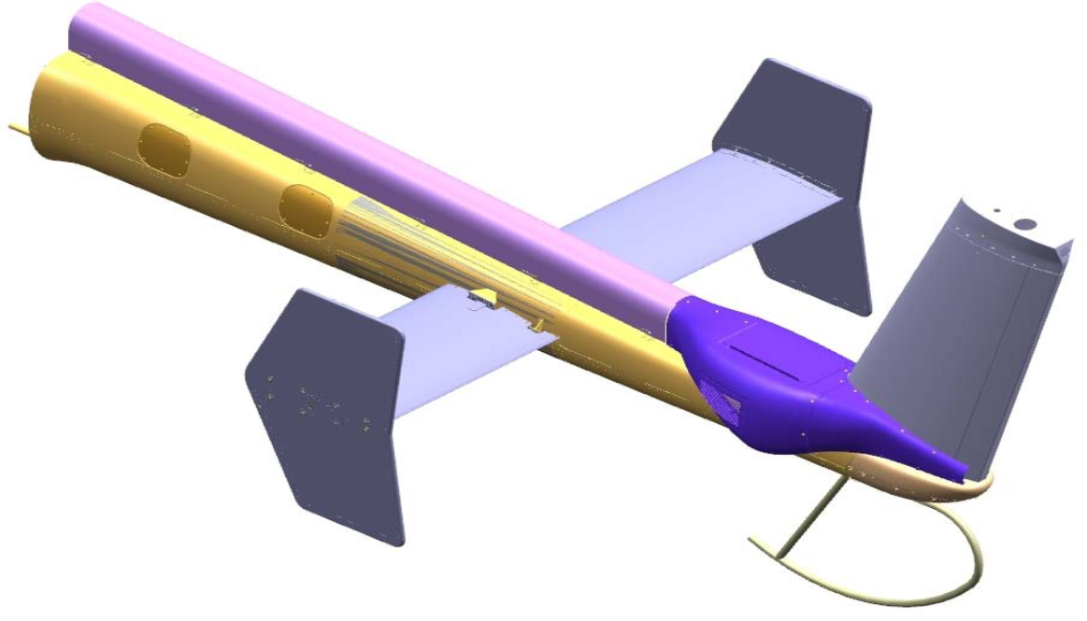
LOCATION
LUH is modeled with low weight fiber composite for horizontal stabilizer and vertical fin.
The Horizontal stabilizer is positioned on the tail boom ahead of the tail rotor
Vertical fin is positioned vertically at the end of tail boom to off load the tail rotor and for yaw control.
The Equipment Panel is positioned inside the cockpit

Slide 7
ABBREVIATIONS
HT - Horizontal Stabilizer
VT - Vertical Fin
ET- Equipment Panel
LUH – HAL Light Utility Helicopter
MATLAB – Matrix Laboratory
XM – Mass Centre
XSM – Shear Centre

Slide 8
DYNAMIC ANALYSIS: LUH HORIZONTAL STABILIZER (HT)
Method Used: FE method
The FE method was used to model the HT using ALTAIR HYPERMESH and the natural frequencies were obtained through modal analysis using NASTRAN.

Slide 9
Horizontal Stabilizer (HT)
The LUH Horizontal stabilizer has a uniform airfoil GAW2 (inverted) profile which is rigidly fixed to the helicopter tail boom with end plates
In addition to torsional motion, bending motion is included in the model and there is a phase shift between torsion and bending motion due to aerodynamic loads.
The first bending mode and the first torsion mode of LUH HT are given below.
The HT 1st Flap bending mode frequency =19.00Hz
The HT 1st Torsional mode frequency =54.74Hz

Slide 10
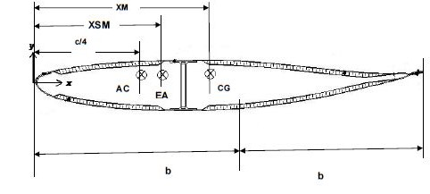
Cross-Section of HT

Slide 11
FE MODEL OF HT

Slide 12
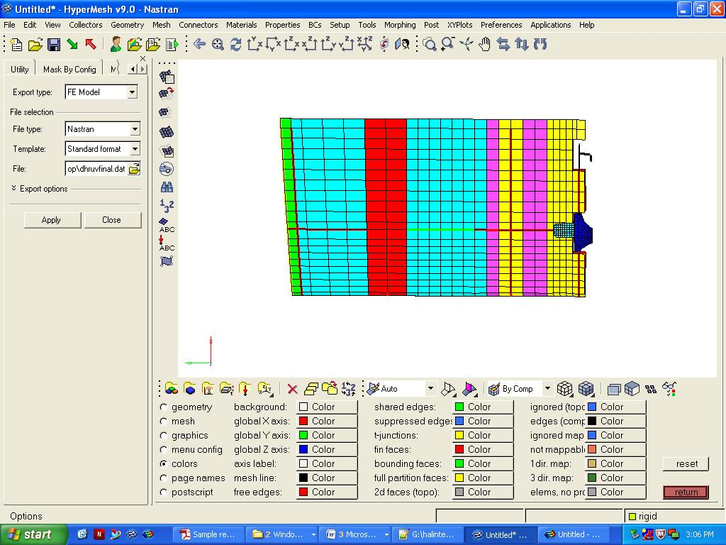
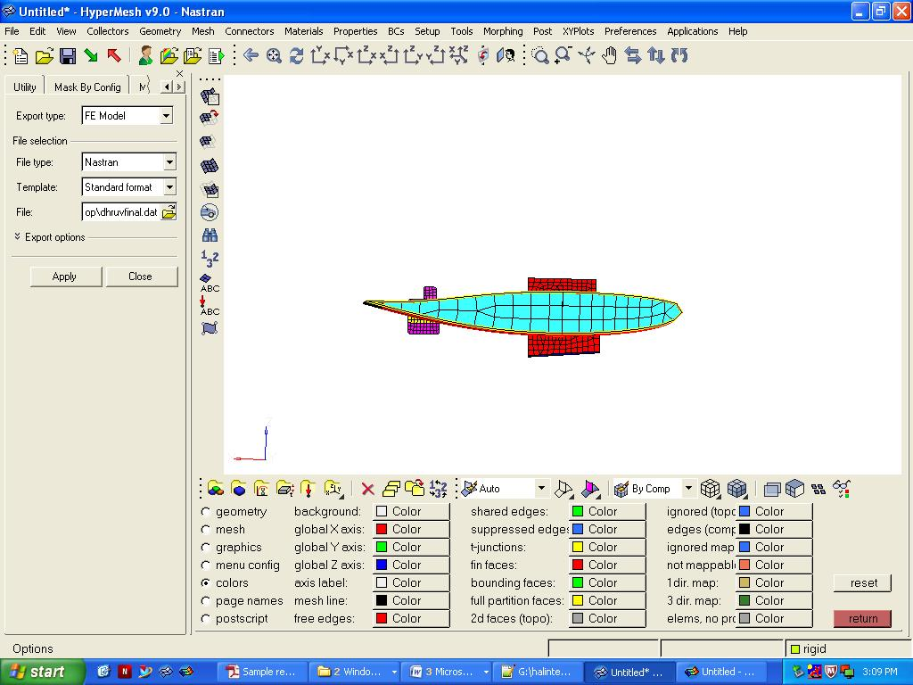
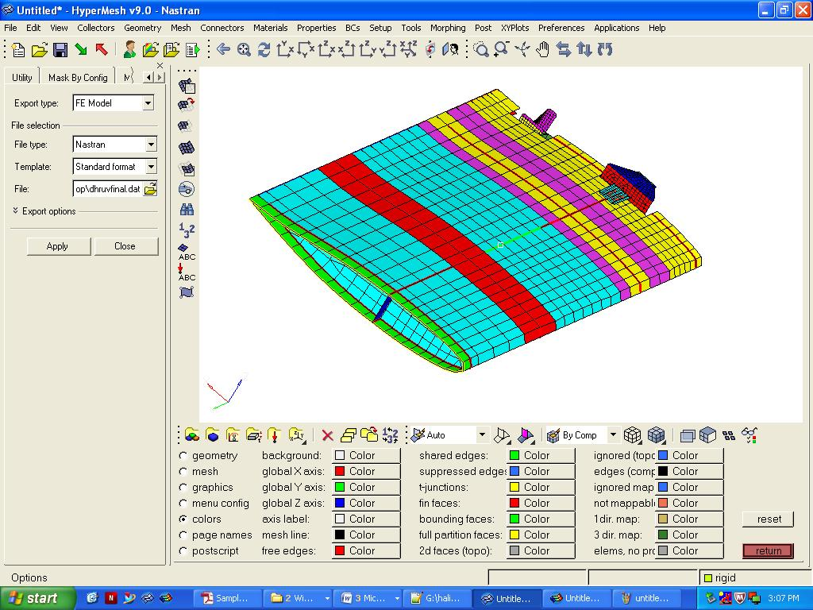
TOP VIEW
SIDE VIEW
ISOMETRIC VIEW

Slide 13
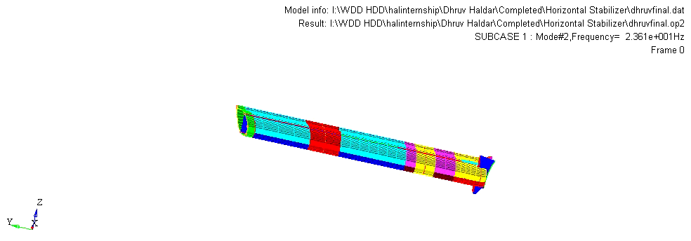
Fundamental Bending Mode= 23.61 Hz

Slide 14
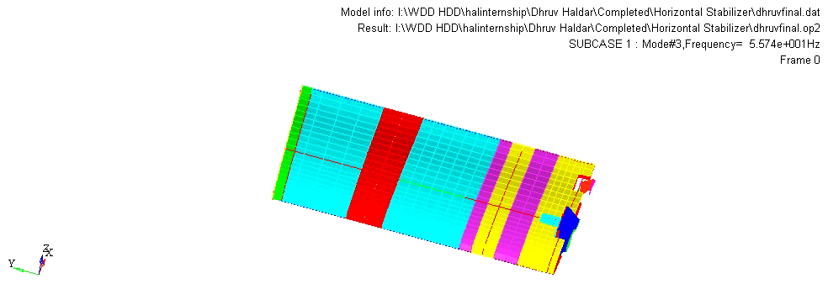
Fundamental Torsion Mode = 55.74 Hz

Slide 15
DYNAMIC ANALYSIS: LUH VERTICAL FIN (VT)
Method Used: FE method
The FE method was used to model the VT using ALTAIR HYPERMESH and the natural frequencies were obtained through modal analysis using NASTRAN.

Slide 16
Vertical Fin (VT)
The LUH Vertical Fin has a NACA0017 truncated airfoil profile
In addition to torsional motion, bending motion is included in the model and there is a phase shift between torsion and bending motion due to aerodynamic loads.
The first bending mode and the first torsion mode of LUH VT are given below.
The VT 1st Flap bending mode frequency = 19.00 Hz
The VT 1st Torsional mode frequency = 54.74 Hz

Slide 17
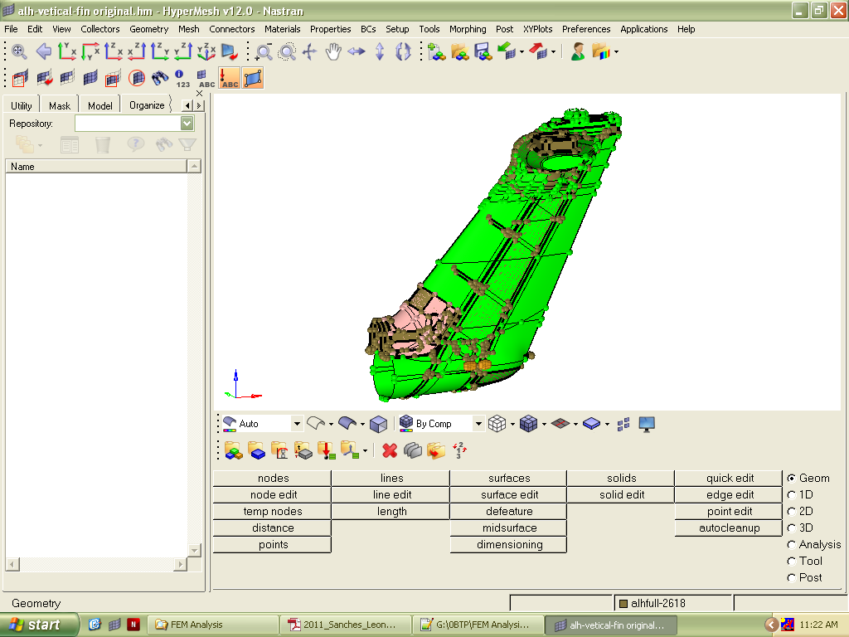
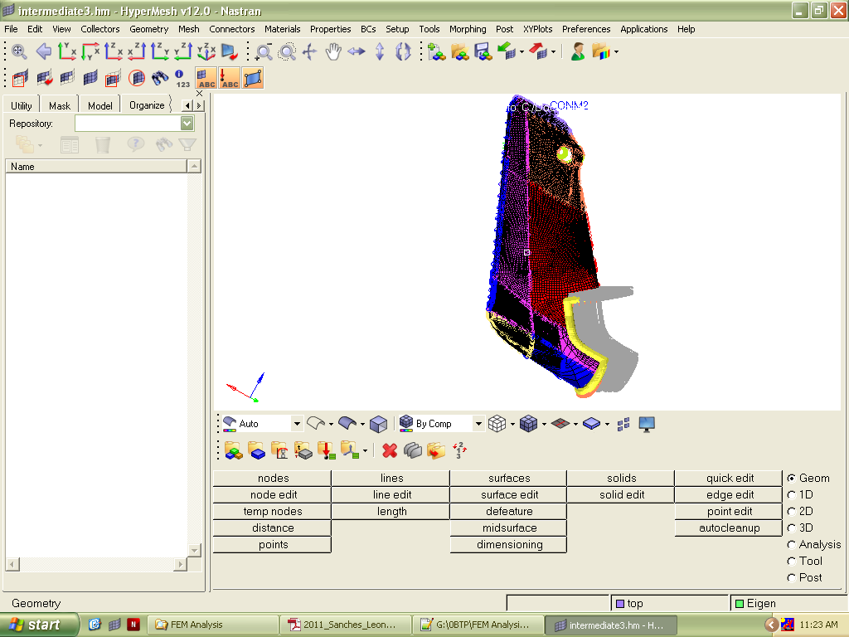
FE Model of LUH VT
Original Geometry
CORRECTED AND MESHED GEOMETRY WITH ASSIGNED MASS (CONM2)

Slide 18
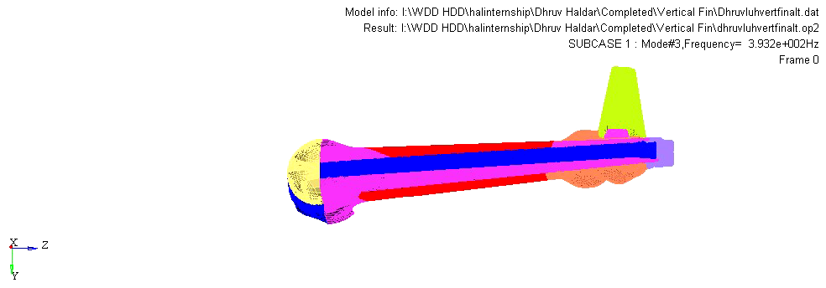
Fundamental Bending Mode= 39.32 Hz

Slide 19

Fundamental Torsion Mode = 60.15 Hz

Slide 20
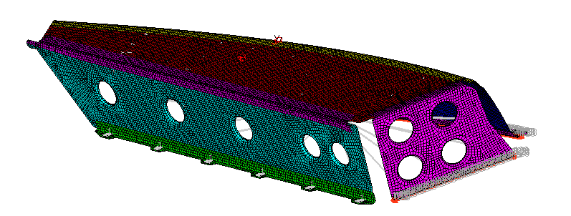
DYNAMIC ANALYSIS: LUH EQUIPMENT PANEL (ET)
FE Model of LUH ET

Slide 21
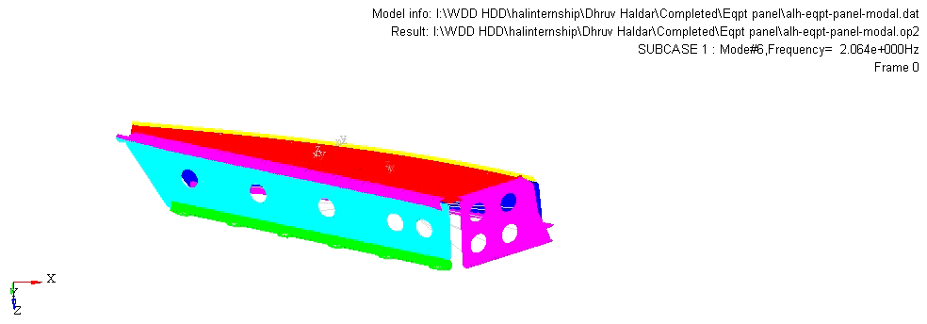
Fundamental Bending Mode= 13.35 Hz

Slide 22

Fundamental Torsion Mode= 17.32 Hz

Slide 23
Procedure for creation of FE Model:
Obtained Original Geometry (CAD Parasolid File of extension .x_t)
Geometry Cleanup: Removal of Red Lines- Free edges (only corrected where required)
Removal of Yellow Lines-Surfaces which are shared by 3 or more surfaces
Green Lines –Required lines / Shared edges
Creation of nodes at the area which is to be attached to the Tail Boom
Meshing: Command AUTOMESH used surface-by-surface

Slide 24
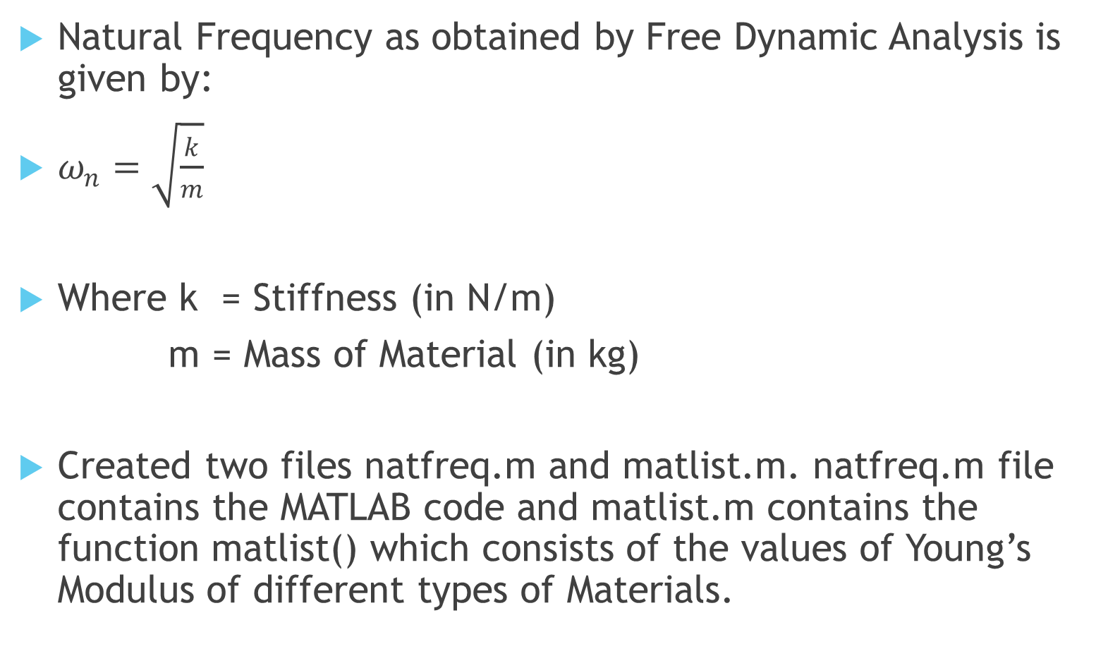
MATLAB code for finding out Natural Frequency
Natural Frequency as obtained by Free Dynamic Analysis is given by:
$ω_{n}=\sqrt{\frac{k}{m}}$
Where k = Stiffness (in N/m)
m = Mass of Material (in kg)
Created two files natfreq.m and matlist.m. natfreq.m file contains the MATLAB code and matlist.m contains the function matlist() which consists of the values of Young’s Modulus of different types of Materials.

Slide 25
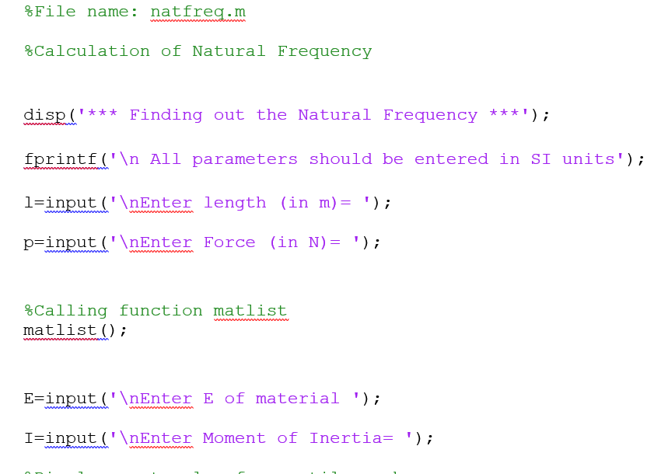
natfreq.m

Slide 26
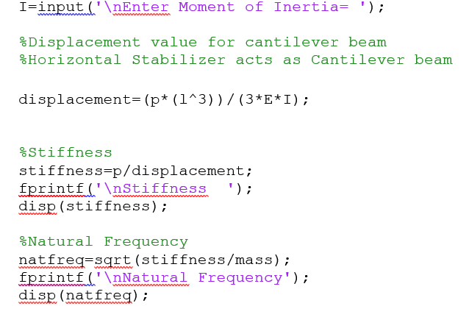
natfreq.m

Slide 27
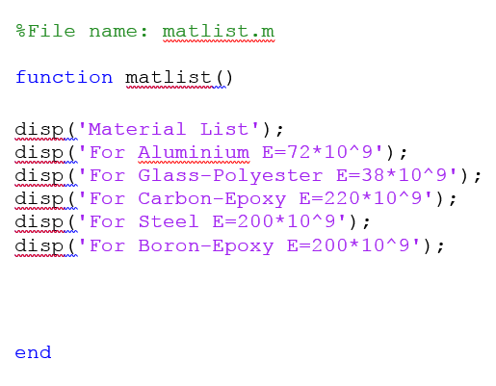
Material Library

Slide 28
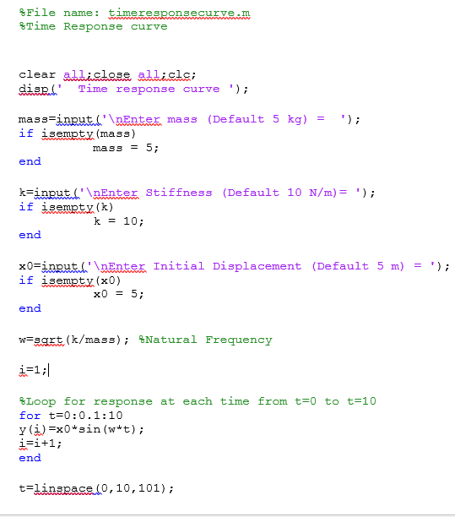
MATLAB code for finding out Time Response Curve

Slide 29
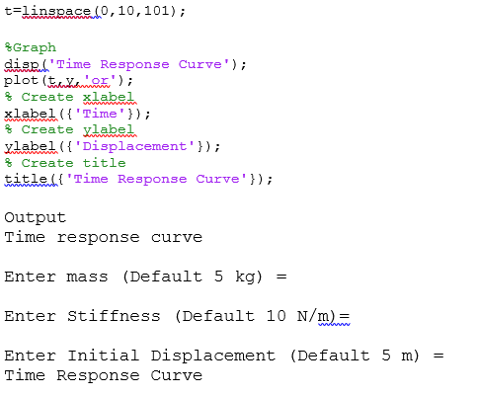
MATLAB code for finding out Time Response Curve

Slide 30
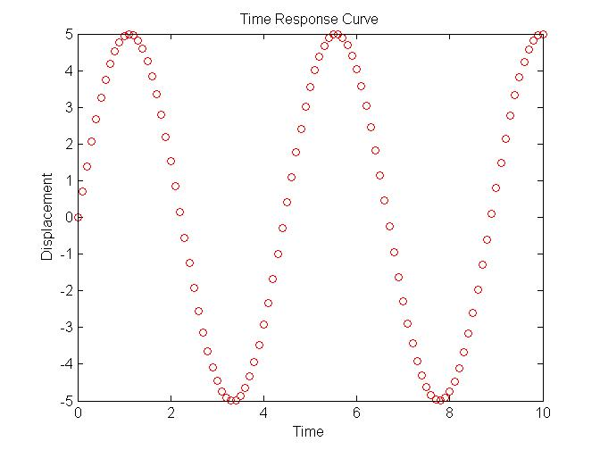
Time Response Curve: Graph generated by Displacement vs Time

Slide 31
CHEETAH & CHEETAK
Cheetah helicopter is a single-engine multi mission helicopter in 2-tonne class with a modern fuel efficient high performance engine TM 333 2M2 fully controlled by Full Authority Digital Electronic Control (FADEC) System in place of ARTOUSTE IIIB engine.
Cheetal is manufactured by Helicopter Division of the Hindustan Aeronautics Limited (HAL).
This is also called as HAL SA216 Alouette III
The Chetak helicopter is a two ton class helicopter operated by several military and civil operators all over the world.
Chetak is manufactured by Helicopter Division of the Hindustan Aeronautics Limited (HAL).
This is also called as HAL SA315B Lamas

Slide 32
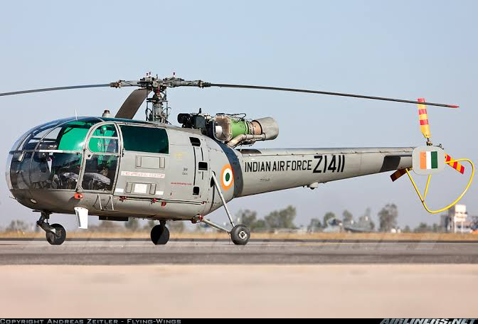
Salient Features of Chetak
The Chetak helicopter is utilized for the following roles:
Communication Duties (Passenger transport)
Cargo/ Material Transport
Casualty Evacuation (CASEVAC)
Search and Rescue (SAR)
Aerial Survey and Patrolling
Emergency Medical Service (EMS)
Electronic News Gathering
Anti- Hijacking
Off shore Operations

Slide 33
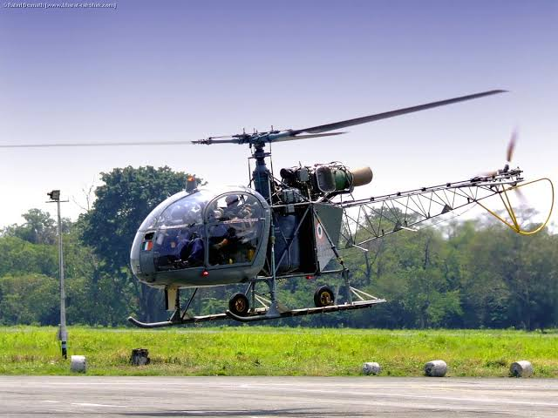
Salient Features of Cheetah
Some of the salient features of Cheetal are:
Elimination of clutch due to free turbine engine.
Introduction of Inversion Gear Box
Modified electrical system/instrument panels by adding DC master box, new engine instruments with modular warning lights.
Introduction of Master warning flasher light in the cockpit, which flashes in the event of any warn, comes ON in cockpit.
Automatic takeover of engine control by Electronic Backup Control Box system (EBCB) in the event of FADEC failure

Slide 34
ALOUETTE III TRANSMISSION SYSTEM
Q. Why use a transmission system in Helicopter?
A. The angular velocity (in rpm) generated from the engine is very high and therefore it needs to be reduced by a significant margin, so transmission system is used in helicopter.

Slide 35
Features of the ALLOUETTE III Transmission system
Used in both Cheetah and Chetak helicopters
Consists of the following components:
Turbine
Main Gear Box (MGB)
Tail Gear Box (TGB)
Main Rotor Head (MRH)
Vent Gear Shaft (VGS)
Tail Rotor Head
Clutch Unit
Free wheel (similar to Flywheel)
Inclined Drive Shaft
Coupling Shaft
Tail Drive Shaft
Angular Velocities of the transmission components are as follows :

Slide 36
Components | Angular Velocity (in rpm)
Engine (Turbine) | 33500
Main Gear box (MGB) | 5770
Vent Gear Shaft (VGS) | 2820
First Stage Planetary Gear | 999
Main Rotor Head (MRH) | 353
Tail Rotor Head (TRH) | 1940
MGB Reduction Ratio | 16.253:1

Slide 37
Conclusion
The dynamic analysis of the horizontal stabilizer and vertical fin of the LUH helicopter is determined. The helicopter is expected to have a maximum speed of 280 Km/h.
Since the natural frequencies do not match the frequencies of rotor, the helicopter is stable and safe for flight.

Slide 38
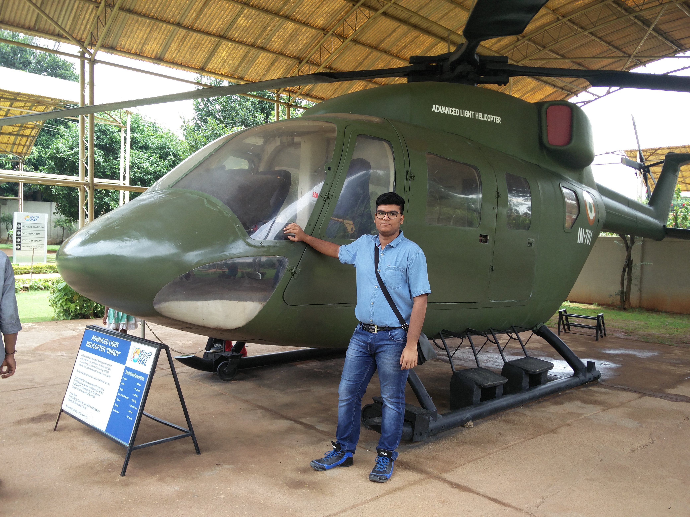
THANK YOU

